Slide 1
A Fast and Practical Bit-Vector Algorithm for the Longest Common Subsequence Problem
M. Crochemore, C.S. Iliopoulos, Y.J. Pinzon, J.F. Reid, Inform. Process. Lett. 80 (2001) 279–285
Speaker: Chia-Hung Chang
Date: April 25, 2007

Slide 2
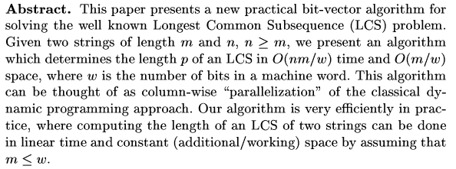

Slide 3

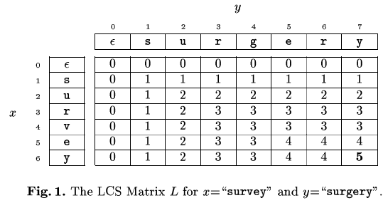
Preliminaries

Slide 4
K-dominant matches
[i,j]
[s,t]
s > i && t <= j
s <= i && t > j

Slide 5
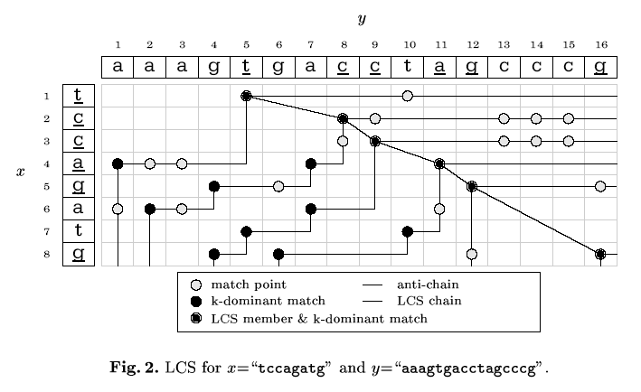

Slide 6
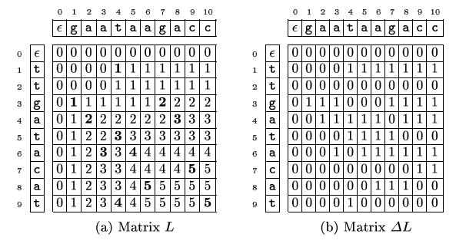

Slide 7
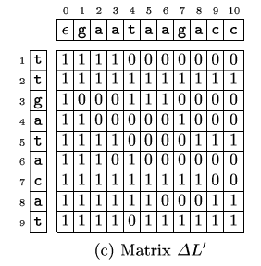

Slide 8
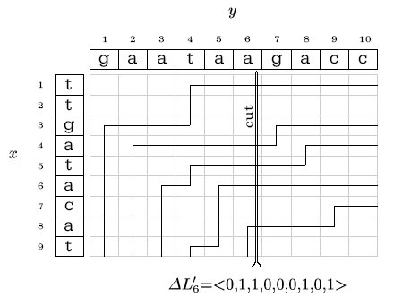

Slide 9
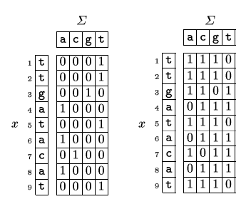
formula

Slide 10
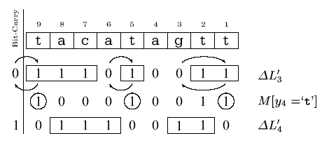

Slide 11
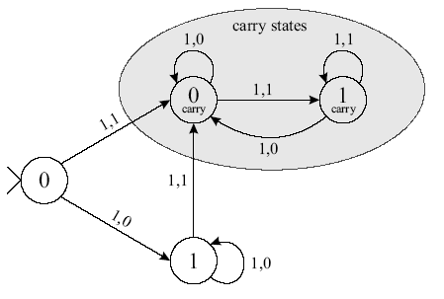

Slide 12
End

